Slide 1
DATA MINING Supervised Learning
Regression
Classification
Decision Trees

Slide 2
Supervised learning
In supervised learning, except for the feature variables that describe the data, we also have a target variable
The goal is to learn a function (model) that can estimate/predict the value of the target variable given the features
We learn the function using a labeled training set.
Regression: The target variable (but also the features) is numerical and continuous
The price of a stock, the GDP of a country, the grade in a class, the height of a child, the life expectancy etc
Classification: The target variable is discrete
Does a taxpayer cheat or not? Will the stock go up or down? Will the student pass or fail? Is a transaction fraudulent or not? What is the topic of an article?

Slide 3
Applications
Descriptive modeling: Explanatory tool to understand the data:
Regression: How does the change in the value of different factors affect our target variable?
What factors contribute to the price of a stock?
What factors contribute to the GDP of a country?
Classification: Understand what attributes distinguish between objects of different classes
Why people cheat on their taxes?
What words make an post offensive?
Predictive modeling: Predict a class of a previously unseen record
Regression: What will the life-expectancy of a patient be?
Classification: Is this a cheater or not? Will the stock go up or not. Is this an offensive post?

Slide 4

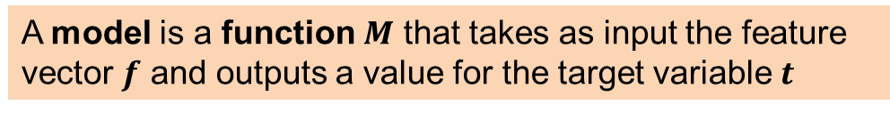









Supervised Learning Overview
$$f_{1}$$
$$f_{2}$$
$$f_{3}$$
$$f_{4}$$
$$f_{1}$$
$$f_{2}$$
$$f_{3}$$
$$f_{4}$$
$$t$$
Learning algorithm
Model
Training data
Train
Apply
Predict
Test data
Evaluate
$$t$$
A model is a function $M$ that takes as input the feature vector $f$ and outputs a value for the target variable $t$

Slide 5
Linear Regression

Slide 6
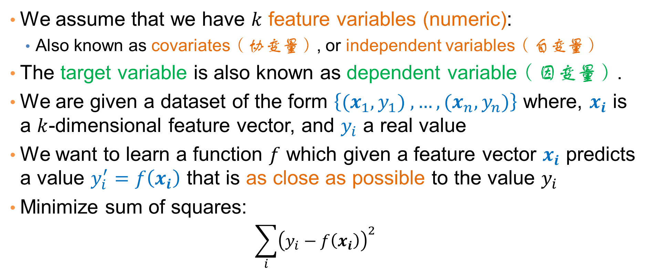
Regression
We assume that we have $k$ feature variables (numeric):
Also known as covariates（协变量）, or independent variables（自变量）
The target variable is also known as dependent variable（因变量）.
We are given a dataset of the form $\left\{{(x}_{1},y_{1}) ,…,{(x}_{n},y_{n})\right\}$ where, $x_{i}$ is a $k$-dimensional feature vector, and $y_{i}$ a real value
We want to learn a function $f$ which given a feature vector $x_{i}$ predicts a value $y_{i}^{′}=f\left(x_{i}\right)$ that is as close as possible to the value $y_{i}$
Minimize sum of squares:
$$\sum_{i}{{\left(y_{i}−f\left(x_{i}\right)\right)}^{2}}$$

Slide 7
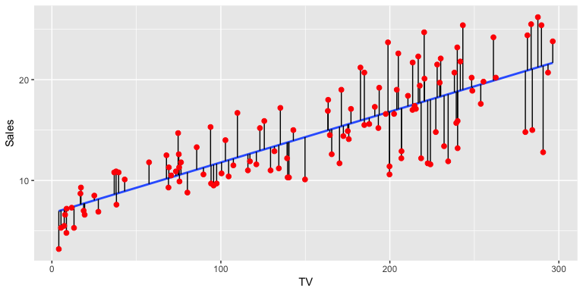
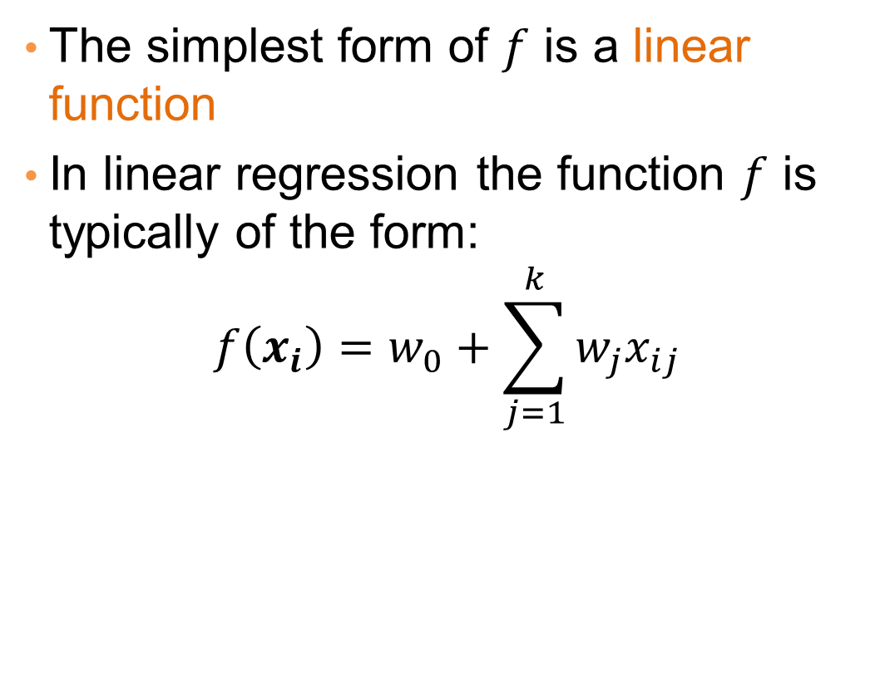



Linear regression
The simplest form of $f$ is a linear function
In linear regression the function $f$ is typically of the form:
$$f\left(x_{i}\right)=w_{0}+\sum_{j=1}^{k}{w_{j}x_{ij}}$$
$w_{0}$:截距
$x_{ij}$:${ x}_{i}$的第j个维度
$w_{j}$: 第j个维度的系数

Slide 8


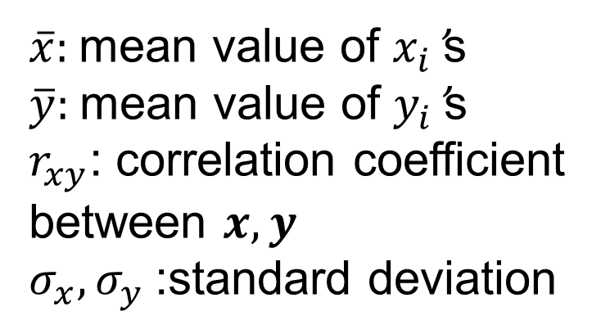
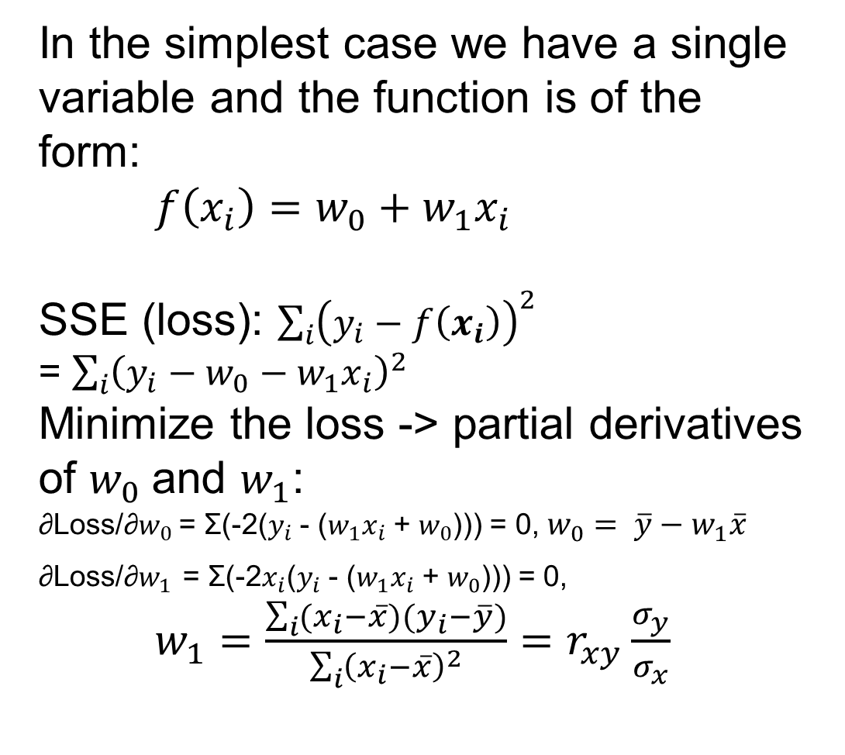
One-dimensional linear regression
In the simplest case we have a single variable and the function is of the form:
$f\left(x_{i}\right)=w_{0}+w_{1}x_{i}$
SSE (loss): $\sum_{i}{{\left(y_{i}−f\left(x_{i}\right)\right)}^{2}}$
= $\sum_{i}{{\left(y_{i}−w_{0}−w_{1}x_{i}\right)}^{2}}$
Minimize the loss -> partial derivatives of $w_{0}$and $w_{1}$:
∂Loss/∂$w_{0}$ = Σ(-2($y_{i}$ - ($w_{1}x_{i}$ + $w_{0}$))) = 0, $w_{0}= \overline{y}−w_{1}\overline{x}$
∂Loss/∂$w_{1}$ = Σ(-2$x_{i}$($y_{i}$ - ($w_{1}x_{i}$ + $w_{0}$))) = 0,
$w_{1}=\frac{\sum_{i}{(x_{i}−\overline{x})(y_{i}−\overline{y})}}{\sum_{i}{{\left(x_{i}−\overline{x}\right)}^{2}}}=r_{xy}\frac{σ_{y}}{σ_{x}}$
产品销量$y_{i}$
广告投入$x_{i}$
$\overline{x}$: mean value of $x_{i}$’s
$\overline{y}$: mean value of $y_{i}$’s
$r_{xy}$: correlation coefficient between $x,y$
$σ_{x}, σ_{y}$:standard deviation

Slide 9
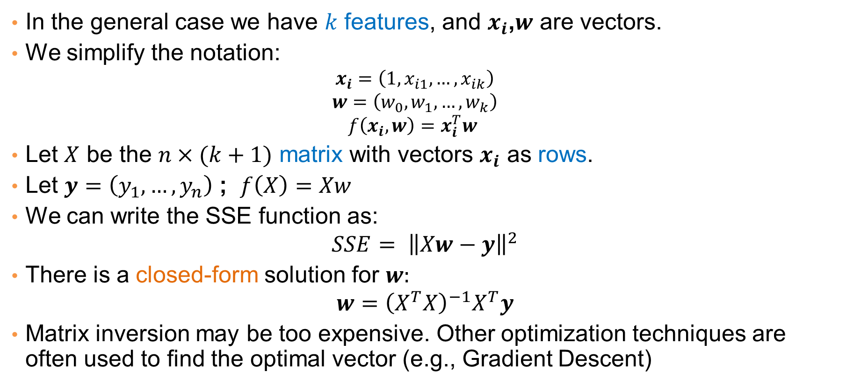

Multiple linear regression
In the general case we have $k$ features, and $x_{i}$,$w$ are vectors.
We simplify the notation:
$$x_{i}=\left(1,x_{i1},…,x_{ik}\right)$$
$$w=\left(w_{0},w_{1},…,w_{k}\right)$$
$$f\left(x_{i},w\right)=x_{i}^{T}w$$
Let $X$ be the $n×(k+1)$ matrix with vectors $x_{i}$ as rows.
Let $y=\left(y_{1},…,y_{n}\right)$ ; $f\left(X\right)=Xw$
We can write the SSE function as:
$$SSE= {\left\|Xw−y\right\|}^{2}$$
There is a closed-form solution for $w:$
$$w={\left(X^{T}X\right)}^{−1}X^{T}y$$
Matrix inversion may be too expensive. Other optimization techniques are often used to find the optimal vector (e.g., Gradient Descent)
（ $x_{i}$和$w$默认列向量）
w的解析解

Slide 10
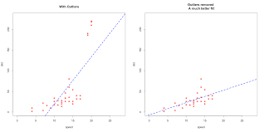
Outliers
Regression is sensitive to outliers:
The line will “tilt” to accommodate very extreme values
Solution: remove the outliers
But make sure that they do not capture useful information
离群值造成倾斜

Slide 11
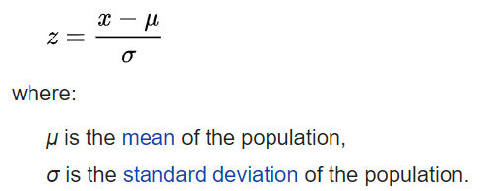
Normalization
In the regression problem some times our features may have very different scales:
For example: predict the GDP of a country using as features the percentage of home owners and the income
The weights in this case will not be interpretable
Solution: Normalize the features by replacing the values with the z-scores
Remove the mean and divide by the standard deviation

Slide 12
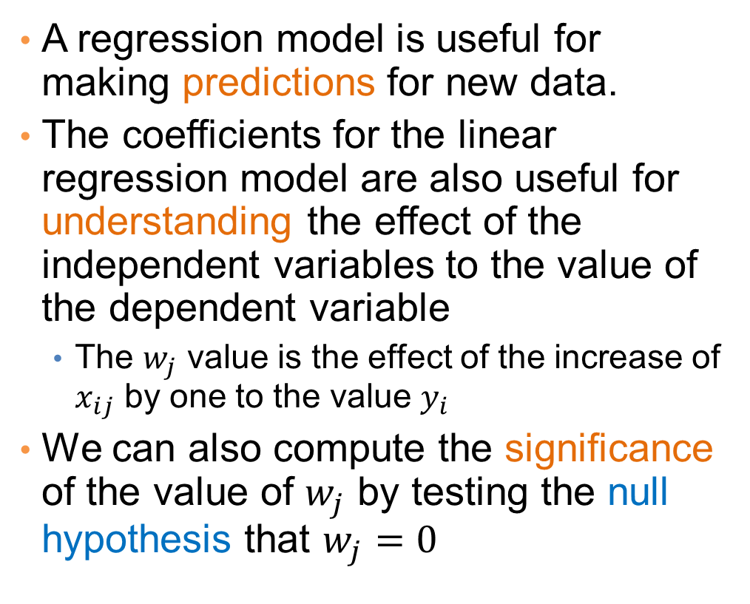
Interpretation and significance
A regression model is useful for making predictions for new data.
The coefficients for the linear regression model are also useful for understanding the effect of the independent variables to the value of the dependent variable
The $w_{j}$ value is the effect of the increase of $x_{ij}$ by one to the value $y_{i}$
We can also compute the significance of the value of $w_{j}$ by testing the null hypothesis that $w_{j}=0$
Predicting Crime rate

Slide 13
Classification

Slide 14
Classification
Similar to the regression problem we have features and a target variable that we want to model/predict
The target variable is now discrete. It is often called the class label
In the simplest case, it is a binary variable.
In classification the features may also be categorical.

Slide 15
Example: Catching tax-evasion
Tax-return data for year 2021
A new tax return for 2022
Is this a cheating tax return?
An instance of the classification problem: learn a method for discriminating between records of different classes (cheaters vs non-cheaters)

Slide 16
Classification
Classification is the task of learning a target function f that maps attribute set x to one of the predefined class labels y
The function may be defined as an algorithm (e.g., if Single and Income < 125K then No)
categorical
categorical
continuous
class
One of the attributes is the class attribute
In this case: Cheat
Two class labels (or classes): Yes (1), No (0)

Slide 17
Examples of Classification Tasks
Categorizing news stories as finance, weather, entertainment, sports
Identifying spam email, spam web pages
Predict the direction of stock market
Classify plant species

Slide 18
General approach to classification
Obtain a training set consisting of records with known class labels
Training set is used to build a classification model
A labeled test set of previously unseen data records is used to evaluate the quality of the model.
The classification model is applied to new records with unknown class labels
Important intermediate step: Decide on what features to use

Slide 19
Illustrating Classification Task
归纳
演绎

Slide 20

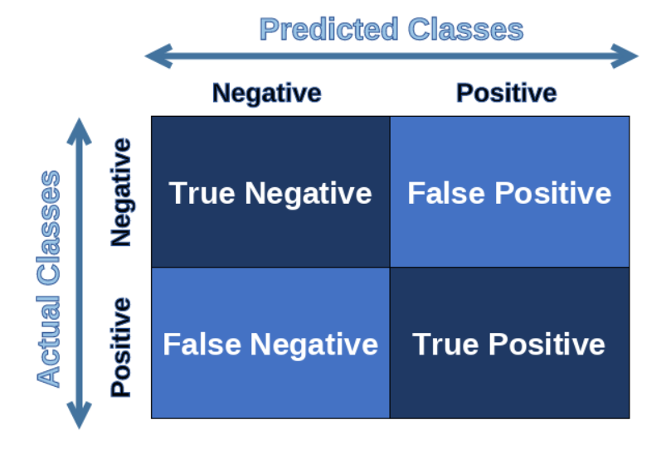

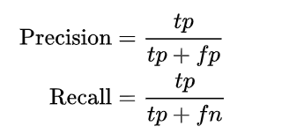

Evaluation of classification models
预测值
Negative/Positive 阴/阳
预测值是否正确
（T/F 真/假）
Confusion matrix
准确率，预测结果正确的比例
Accuracy can be a misleading metric for imbalanced data sets
真阴性
假阳性
精确率，预测为阳性的案例里面正确
的比例
真阳性
召回率，所有实际为阳性的案例里面，
有被预测正确的比例
假阴性
F measure:
precision和recall的调和平均

Slide 21
Classification Techniques
Decision Tree based Methods
Rule-based Methods
Memory based reasoning
Neural Networks
Naïve Bayes and Bayesian Belief Networks
Support Vector Machines
Logistic Regression

Slide 22
DECISION TREES

Slide 23
Decision Trees
Decision tree
A flow-chart-like tree structure
Internal node denotes a test on an attribute
Branch represents an outcome of the test
Leaf nodes represent class labels or class distribution

Slide 24
Example of a Decision Tree
categorical
categorical
continuous
class
Splitting Attributes
Refund
Yes
No
Test outcome
NO
MarSt
Single, Divorced
Married
TaxInc
NO
< 80K
>= 80K
NO
YES
Class labels
Training Data
Model: Decision Tree

Slide 25
Another Example of Decision Tree
categorical
categorical
continuous
class
MarSt
Single, Divorced
Married
NO
Refund
Yes
No
NO
TaxInc
< 80K
>= 80K
NO
YES
There could be more than one tree that fits the same data!

Slide 26
Decision Tree Classification Task
Decision Tree

Slide 27
Apply Model to Test Data
Test Data
Start from the root of tree.
Refund
Yes
No
NO
MarSt
Single, Divorced
Married
TaxInc
NO
< 80K
> 80K
NO
YES

Slide 28
Apply Model to Test Data
Test Data
Refund
Yes
No
NO
MarSt
Single, Divorced
Married
TaxInc
NO
< 80K
> 80K
NO
YES

Slide 29
Apply Model to Test Data
Test Data
Refund
Yes
No
NO
MarSt
Single, Divorced
Married
TaxInc
NO
< 80K
> 80K
NO
YES

Slide 30
Apply Model to Test Data
Test Data
Refund
Yes
No
NO
MarSt
Single, Divorced
Married
TaxInc
NO
< 80K
> 80K
NO
YES

Slide 31
Apply Model to Test Data
Test Data
Refund
Yes
No
NO
MarSt
Single, Divorced
Married
TaxInc
NO
< 80K
> 80K
NO
YES

Slide 32
Apply Model to Test Data
Test Data
Refund
Yes
No
NO
MarSt
Single, Divorced
Married
Assign Cheat to “No”
TaxInc
NO
< 80K
> 80K
NO
YES

Slide 33
Decision Tree Classification Task
Decision Tree

Slide 34
Tree Induction
Goal: Find the tree that has low classification error in the training data (training error)
Finding the best decision tree (lowest training error) is NP-hard
Greedy strategy.
Split the records based on an attribute test that optimizes certain criterion.
Many Algorithms:
Hunt’s Algorithm (one of the earliest)
CART
ID3, C4.5
《导论》P70

Slide 35

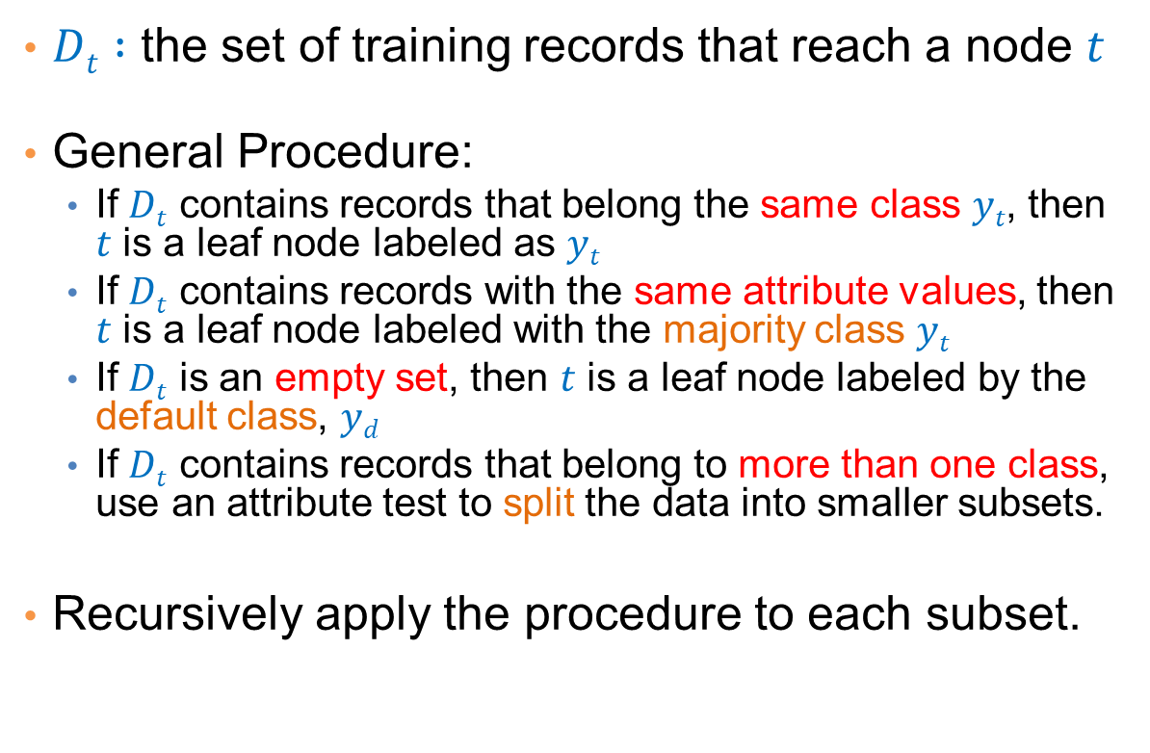
General Structure of Hunt’s Algorithm
$Dt :$ the set of training records that reach a node $t$
General Procedure:
If $Dt$ contains records that belong the same class $yt$, then $t$ is a leaf node labeled as $yt$
If $Dt$ contains records with the same attribute values, then $t$ is a leaf node labeled with the majority class $yt$
If $Dt$ is an empty set, then $t$ is a leaf node labeled by the default class, $yd$
If $Dt$ contains records that belong to more than one class, use an attribute test to split the data into smaller subsets.
Recursively apply the procedure to each subset.
$$Dt$$
?

Slide 36
Hunt’s Algorithm
Refund
Don’t
Cheat
Yes
No
Don’t
Cheat
Don’t
Cheat
Refund
Refund
Yes
No
Yes
No
Don’t
Cheat
Marital
Status
Don’t
Cheat
Marital
Status
Single,
Divorced
Single,
Divorced
Married
Married
Cheat
Don’t
Cheat
Taxable
Income
Don’t
Cheat
< 80K
>= 80K
Don’t
Cheat
Cheat

Slide 37
Constructing decision-trees (pseudocode)
GenDecTree(Sample S, Features F)
If stopping_condition(S,F) = true then
leaf = createNode()
leaf.label= Classify(S)
return leaf
root = createNode()
root.test_condition = findBestSplit(S,F)
V = {v| v a possible outcome of root.test_condition}
for each value vєV:
S_{v}: = {s | root.test_condition(s) = v and s є S};
child = GenDecTree(S_{v} ,F) ;
Add child as a descent of root and label the edge (root→child) as v
return root
满足终止条件，创建并返回叶节点
创建根节点，找到最佳拆分属性和测试条件
根据测试条件进行拆分，对于每个子数据集，递归调用GenDecTree，生成一个节点，并作为根节点的子节点
返回根节点

Slide 38
Tree Induction
Issues
How to Classify a leaf node
Assign the majority class
If leaf is empty, assign the default class – the class that has the highest popularity (overall or in the parent node).
Determine how to split the records
How to specify the attribute test condition?
How to determine the best split?
Determine when to stop splitting
Same labels or same attribute values
Early stop to avoid overfitting
属性测试条件是什么？
选哪个属性进行分割
《导论》P85

Slide 39
How to Specify Test Condition?
Depends on attribute types
Nominal
Ordinal
Continuous
Depends on number of ways to split
2-way split
Multi-way split
标称属性，不带顺序
序数属性，带顺序
连续属性，数值型
二元划分
多路划分

Slide 40
Splitting Based on Nominal Attributes
Multi-way split: Use as many partitions as distinct values.
Binary split: Divides values into two subsets. Need to find optimal partitioning.
CarType
Family
Luxury
Sports
CarType
OR
CarType
{Sports, Luxury}
{Family, Luxury}
{Family}
{Sports}

Slide 41
Splitting Based on Ordinal Attributes
Multi-way split: Use as many partitions as distinct values.
Binary split: Divides values into two subsets – respects the order. Need to find optimal partitioning.
What about this split?
Size
Small
Large
Medium
Size
Size
{Small, Medium}
OR
{Medium, Large}
{Large}
{Small}
Size
{Small, Large}
{Medium}

Slide 42
Splitting Based on Continuous Attributes
Different ways of handling
Discretization to form an ordinal categorical attribute
Static – discretize once at the beginning
Dynamic – ranges can be found by equal interval bucketing, equal frequency bucketing (percentiles), or clustering.
Binary Decision: (A < v) or (A ≥ v)
consider all possible splits and finds the best cut
can be more computationally intensive

Slide 43
Splitting Based on Continuous Attributes

Slide 44
How to determine the Best Split
Before Splitting: 10 records of class 0, 10 records of class 1
Which test condition is the best?

Slide 45
How to determine the Best Split
Greedy approach:
Creation of nodes with homogeneous class distribution is preferred
Need a measure of node impurity:
不纯性
Smaller tree, less likely to be overfitted, less training and testing time
Non-homogeneous,
High degree of impurity
Homogeneous,
Low degree of impurity

Slide 46
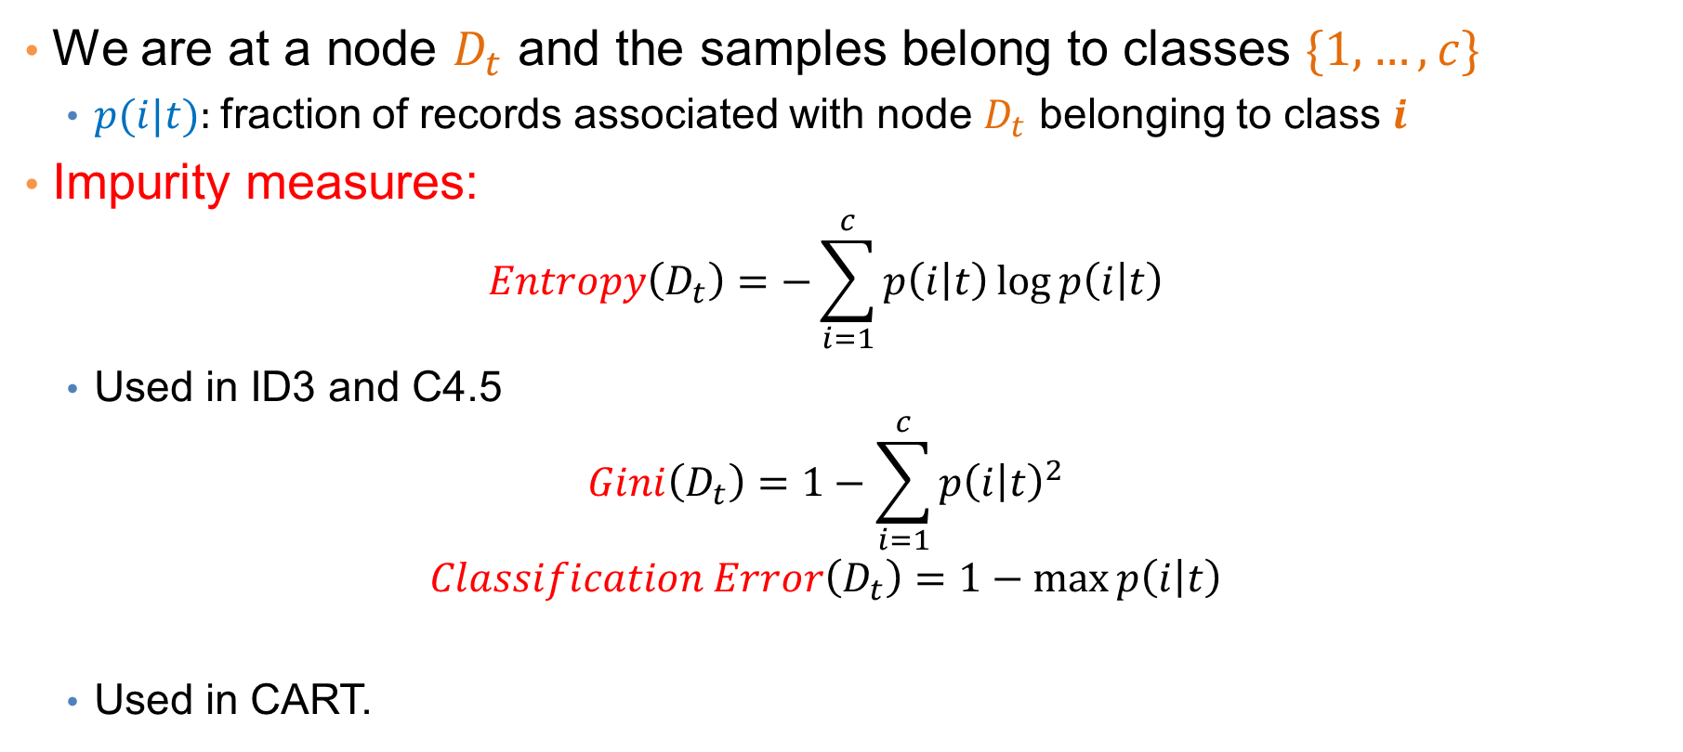
Measuring Node Impurity
We are at a node $D_{t}$ and the samples belong to classes $\{1,…,c\}$
$p(i|t):$fraction of records associated with node $D_{t}$ belonging to class $i$
Impurity measures:
$$Entropy\left(D_{t}\right)=−\sum_{i=1}^{c}{p\left(i | t\right)\log{p\left(i | t\right)}}$$
Used in ID3 and C4.5
$$Gini\left(D_{t}\right)=1−\sum_{i=1}^{c}{p{\left(i | t\right)}^{2}}$$
$$Classification Error\left(D_{t}\right)=1−\max{p\left(i | t\right)}$$
Used in CART.
For more, see 《导论》P73

